Slide 1
Restaurant Recommender system
In Gurgaon

Slide 2
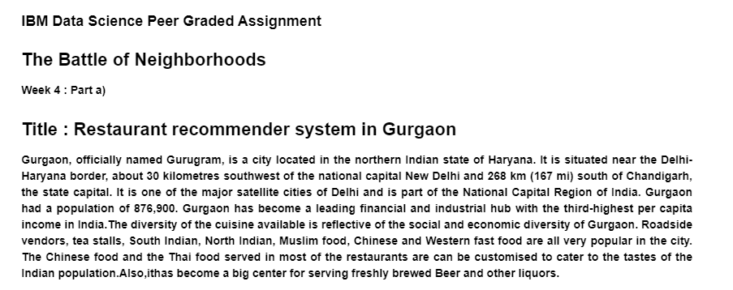

Slide 3
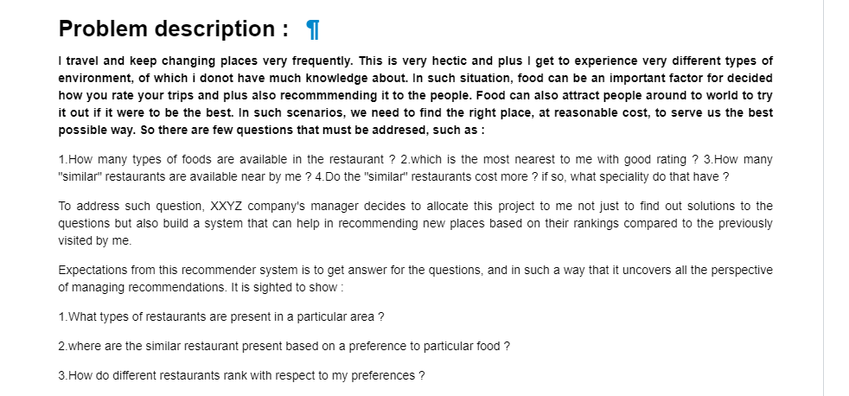

Slide 4
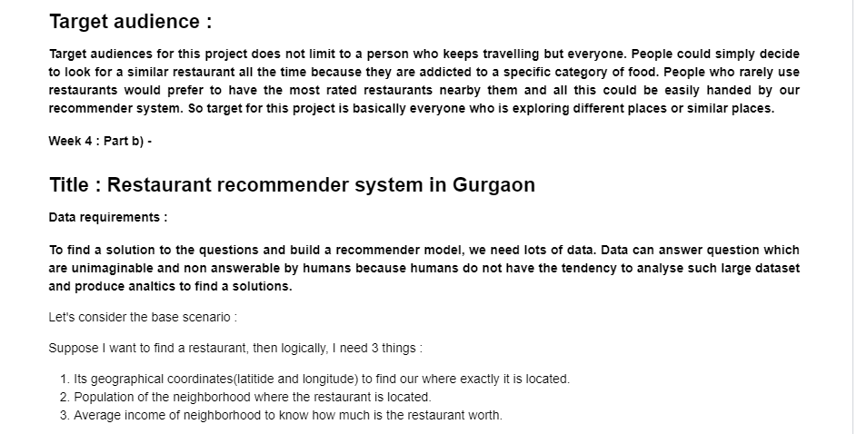

Slide 5
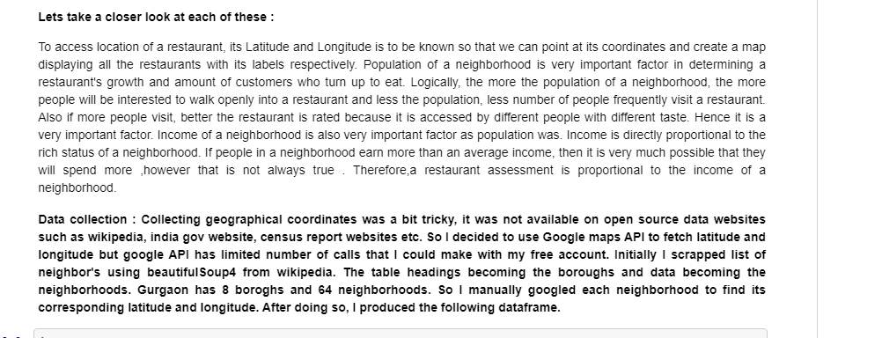

Slide 6
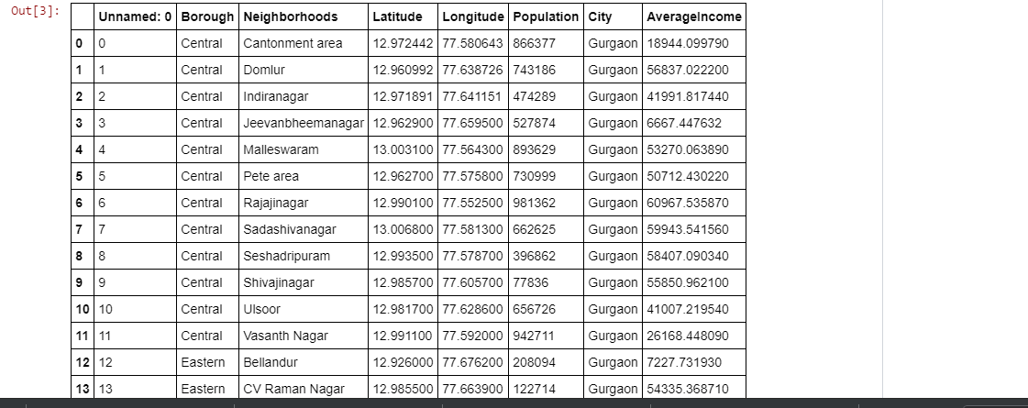

Slide 7


Slide 8
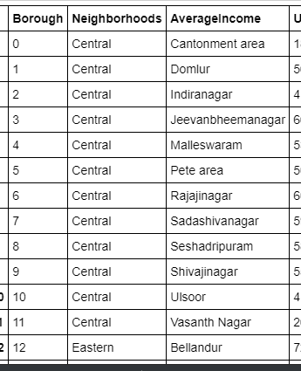
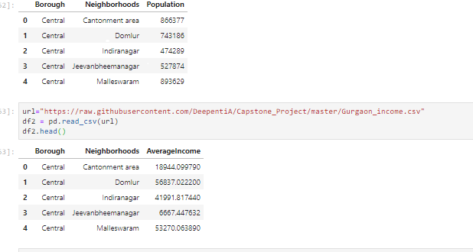

Slide 9
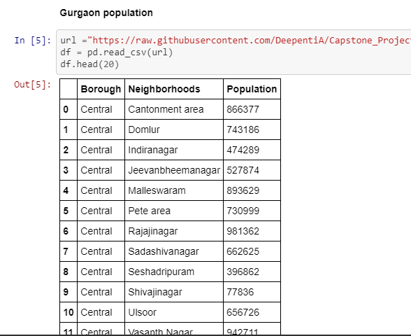

Slide 11
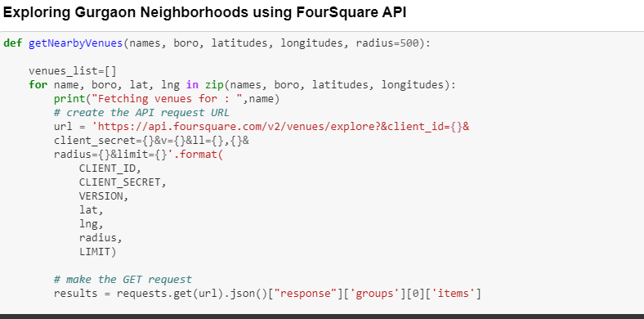

Slide 12
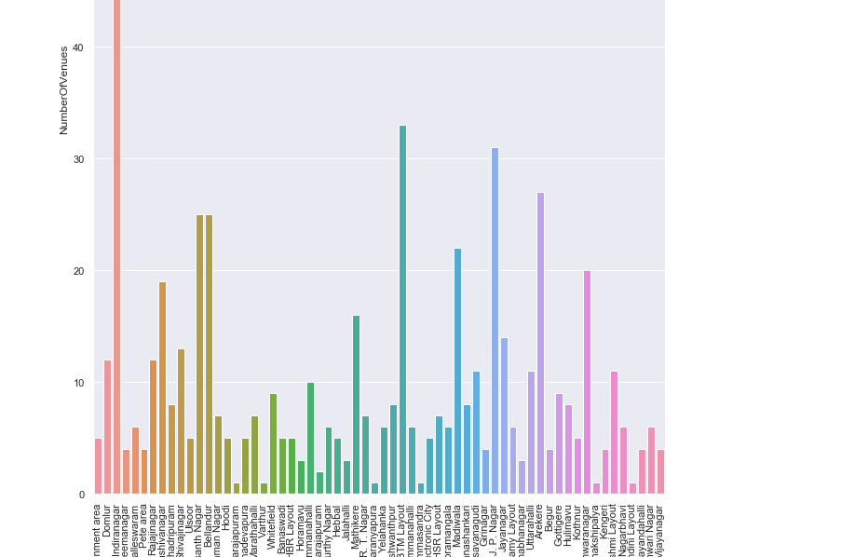

Slide 13


Slide 14
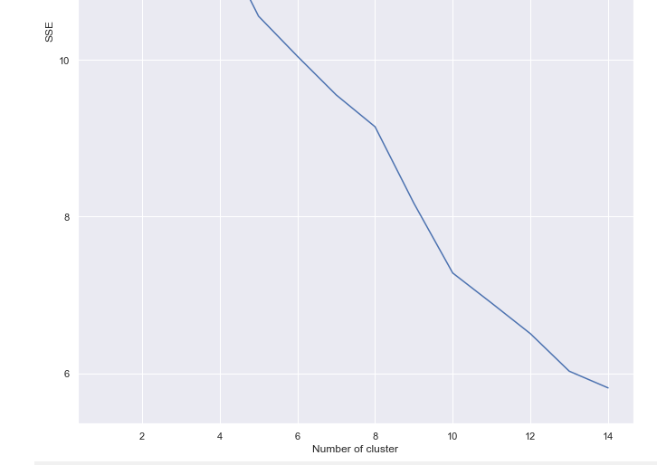

Slide 15
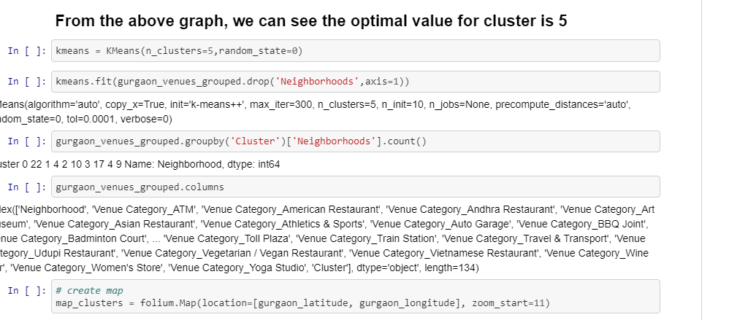

Slide 16
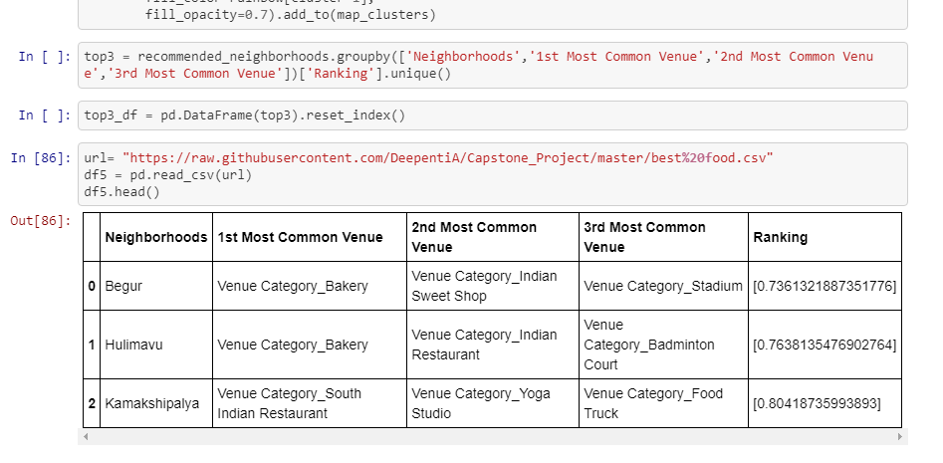

Slide 17
Conclusion :
Here, according the data, we see that 'Begur,Hulimavu and kamakshipalya' are top 3 neighborhoods to find similar food to whitefield restaurant's veg food ! Here our model will recommend these neighborneeds and top 3 common venues to visit

